Slide 1
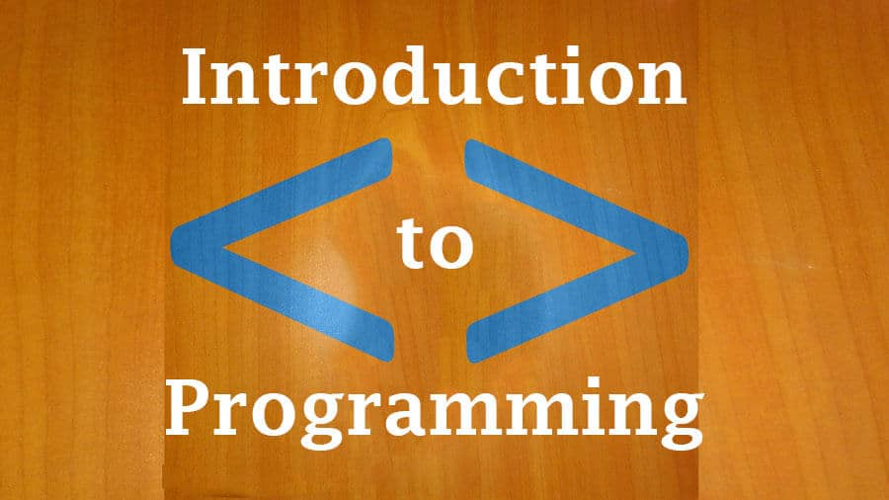
Chapter Five :
Variables, Constants, Functions and Procedures
1008_Introduction to Programming
Compiled by Ms. Dianne Sikinapi & Ms. Odilia Tita

Slide 2
Learning Objectives
By the end of this Unit, students should be able to:
  Distinguish between Variables, Constants and Controls
  Differentiate among the various Data Types
  Learn and know the Data Types and their Prefixes
  Know the Parts of a Variable
  Apply Naming Conventions
  Distinguish between Named and Intrinsic Constants
  Understand the Scope of Variables and be able to distinguish between Global, Module Level and Local Scope
  Understand how to perform Calculations (basic Arithmetic Operation) in Visual Basic
  See Textbook - Introduction to Programming Book 2 Pages 119 - 150

Slide 3
5.1 Variable and Constant
Data is everywhere and data is an important part of an application.
Let’s take a few examples:
  A simple game needs to store the name of the user and the score scored by the user.
  Facebook needs to store the number of likes and comments on a particular post.
  An audio player needs to store the number of songs on a playlist.
And the list goes on. Thus, we need to take care of all such data and store it somewhere. Well, here the concept of Variable comes to our rescue.
A Variable allows us to store data into the memory that can be used and manipulated later. One thing to keep in mind is, generally, this data keeps on changing over a period of time. Like;
  The score of the game keeps on changing.
  The number of likes and comments on Facebook can change.
  The number of songs on a playlist can change.

Slide 4
What is a Variable in Programming?
In programming, a variable is defined as a value that can change, or is able to change depending on conditions or on information passed to the program.
Typically, a program consists of instructions that tell the computer what to do and data that the program uses when it is running or executing.
For example, in a game a variable could be the current score of the player; we would add 1 to the variable whenever the player gained a point (the variable changes).
Variables are used to store information to be referenced and manipulated in a computer program. They also provide a way of labeling data with a descriptive name, so our programs can be understood more clearly by the reader and ourselves. It is helpful to think of variables as containers that hold information.

Slide 5
Parts of a Variable
A Simple Example of Declaring a Variable
A variable has basically 4 parts:
1. data_type - Type of data we wish to store in the variable
2. variable_name - The name we wish to give to the variable
3. = - Equal To sign is used to assign value to a variable
4. value - The value that we need to store.
Let us define a variable to store the age of the user.
int age = 18
Here,
  int is the type of data. int stands for Integer and is used to store numeric values.
  age is the name of the variable. The memory where we will store the value will be referred to as the age.
  = is the assignment sign. It is used to assign value to a variable.
  18 is the value stored in the variable named age.

Slide 6
What is a Constant in Programming?
While, a variable is a name given to the memory location that holds data that can be changed during program execution, a constant is a memory location that holds data that cannot be changed during program execution.
Constants are useful because they are declared and assigned once, but can be referred to over and over again throughout the program.
For example, PI = 3.1415927 whose value is universal and does not change.
Constants provide a way to use words to describe that value that does not change. In the previous chapters, we have use Visual Basic Constants such as vbBlue, vbRed, and so on. Those constants are built into Visual Basic – you don’t need to define them anywhere.

Slide 7
There are two types of constants:
  Named Constants
  Intrinsic Constants
The constants that you define for yourself are called named constants and those that are built into VB are called intrinsic constants.
You declare named constant using the keyword ‘const’. You give the constant a name, a data type and a value. Once a value is declared as a constant, it cannot be changed during the execution of a program. The data type that you declare and the data type of the value must be matched. For example, if you declare an integer constant, you must give it an integer value.
The general Form of a Constant Statement is:
Const Identifier [As Datatype] = Value

Slide 8
Naming convention for constants require a prefix that identify the data type as well as the “As” clause that actually declares the data type.
The example below sets the company name, address and the sales tax as constants:
    Const strCompanyName As String = “S n S_for Stop n Shop”
    Const strCompanyAddress As String = “101 S. Main Street”
    Const curSalesTaxRate = .08

Slide 9
5.2 Data Type in Programming?
We have already discovered that a program hold the data we work with in memory locations called variables. The amount of memory used for a variable depends on how much it has to hold, and that, in turn, depends on what the data consist of.
There are many different types of data that programs need to work with. Each programming language supports the range of data types that has rules about what we can do with each data types.

Slide 10
Most of the data that programs work with could be classified into the following categories as shown in the table below.
Data Types | Description
Boolean | True or False values
Byte | Stores any kind of binary data in an undifferentiated byte stream. You can think of a byte as one letter. For example, the letter 'h' is one byte, and the word 'hope' is four bytes.
Currency | Decimal fractions, such as dollars and cents.
Date | An eight-character date
Double | Define numeric variables holding numbers with decimal points
Integer | Stores whole numbers or real numbers that do not have remainders
Long | Larger whole number
Single | Floating point numbers with six digits
String | Alphabetic data: letters, digits and other characters
Variant | Convert from one type to another, as needed.

Slide 11
Commonly Used Data Types
Note that the default data type is variant. With this data type, if you do not specify a data type in a program, the variables and constants in that program will be variants.
The most common types of variables and constants used are strings, integers and currency.
When deciding which data type to use, follow these guidelines:
  If the data will be used in calculation, then it must be numeric (integer or currency)
  If the data will not be used in calculation, it will be string.
Currency data type is used for any decimal fraction in business application; single and double data types are generally used in scientific application.
Consider the following examples:
Content | Data Type | Reason
Social Security Number | String | Not used in calculation
Pay Rate | Currency | Used in calculation, contain a decimal point
Hours worked | Currency | Used in calculation, may contain a decimal point.
Phone number | String | Not used in calculation
Quantity | Integer | Used in calculation, contains a whole number

Slide 12
5.3 Naming Conventions in Programming
Since variables store data in a program, each programmer has to name (identify/declare) the variable and name constant that will be used in the project.
"Identifiers" or "symbols" are the names you supply for variables, types, functions, and labels in your program. Identifier names must differ in spelling and case from any keywords. You can't use keywords as identifiers; they're reserved for special use.
BASIC requires identifiers for variables and named constants to follow this rule:
  Name must be 1 to 255 character in length
  They may include letters
  The first character must be a letter
  Not reserved words (keywords) must be used

Slide 13
When naming variables and constants, you must follow the rules of each programming language (for example, BASIC). In addition, you should follow some naming conventions.
Conventions are the guidelines that separate good names from bad (not so good) names. This means the meaning and use of all identifiers should always be clear.
The following conventions are widely used in the programming industry.
  Identifiers must be meaningful. Choose a name that clearly indicates its purpose. Do not use abbreviations unless the meaning is obvious and do not use very short identifiers, such as X or Y.
  Precede each identifier with a lower case prefix that specifies the data type.
  Capitalize each word of the name (Following the prefix). Always use mix case, never use all uppercase.

Slide 14
Below is a list of the most common data types and their prefixes (to the right) and a Sample Identifier (to the left).
Data Types | Prefix
Boolean | bln
Currency | cur
Date/Time | dtm
Double | dbl
Integer | int
Long Integer | lng
Single | sng
String | str
Variant | vnt
Field of Data | Possible Identifier
Social Security Number | strSocialSecurityNumber
Pay Rate | curPayRate
Hours Worked | curHoursWorked
Phone Number | strPhoneNumber
Ouantity | intQuantity
Tax Rate (constant) | curTaxRate
Quota (constant) | intQuota
Population | lngPopulation

Slide 15
5.4 Scope of Variables
A variable may exist and may visible for the entire project, for only one form or for only one procedure.
The visibility of a variable is referred to as Scope. Visibility really means ‘this variable can be used or seen in this location’.
There are three types of variable scopes.
  Global – global variables may be used in all procedure of a project.
  Module Level – module level variables are accessible in all procedure of a form.
  Local – local variable may be used only within the procedure in which it is declared.
You declare the scope of a variable by choosing where to place the Dim statement.
In Visual Basic (VB), the Dim statement is used to declare a variable.
The term “Dim” means “Dimension” and it is a keyword that denotes the creation of a variable. The basic syntax to declare variables using the Dim statement is:
    Dim variableName As DataType

Slide 16
Calculations: Arithmetic Operation
In programming, you can perform calculation with variables, constants and with the properties of certain objects.
You can perform the basic Arithmetic Operation in Visual Basic. The basic arithmetic operations you can perform in VB includes the following:
Operator | Operation
+ | Addition
- | Subtraction
* | Multiplication
/ | Division (take normal quotient)
\ | Integer Division (take only the whole, discard remainder)
Mod | Modulus Division (take remainder, discard whole)
^ | Exponentiation

Slide 17
Order of Operation
The order in which operations are performed determines the result. Consider the expression 3 + 4 * 2. What will be the result? If the addition is done first, the result is 14, however if the multiplication is done first, the result is 11.
In programming, there is an order that is followed when dealing with operations. It is called Operator Precedence (Order of Precedence).
Operator Precedence specifies the manner in which operands are grouped with operators. It determines the order which the operators in an expression are evaluated.
The hierarchy of operation or Order of Precedence in arithmetic expression is from the highest to the lowest, which is:
  Exponent
  Multiplication and Division
  Addition and Subtraction
  Parenthesis change the order of evaluation.

Slide 18
Exercise (Order of Precedence)
What will be the result of the following calculation using the Order of Precedence?
Assume X = 2, Y = 4, Z = 3
X + Y ^ 2 =
8 / Y / Z =
X * ( X + 1 ) =
X * X + 1 =
Y ^ X + Z * 2 =
Y ^ ( X + Z ) * 2 =
( Y ^ X ) + Z * 2 =
((Y ^ X ) + Z ) * 2 =

Slide 19
Summary
Read Chapter Summary Notes on Page 148 of Introduction to Programming Book 2.
Review Exercises
Complete all 9 review questions on Page 149 of Introduction to Programming Book 2.
Try to at least do Hands-On Programming Examples and Exercises

